Slide 1
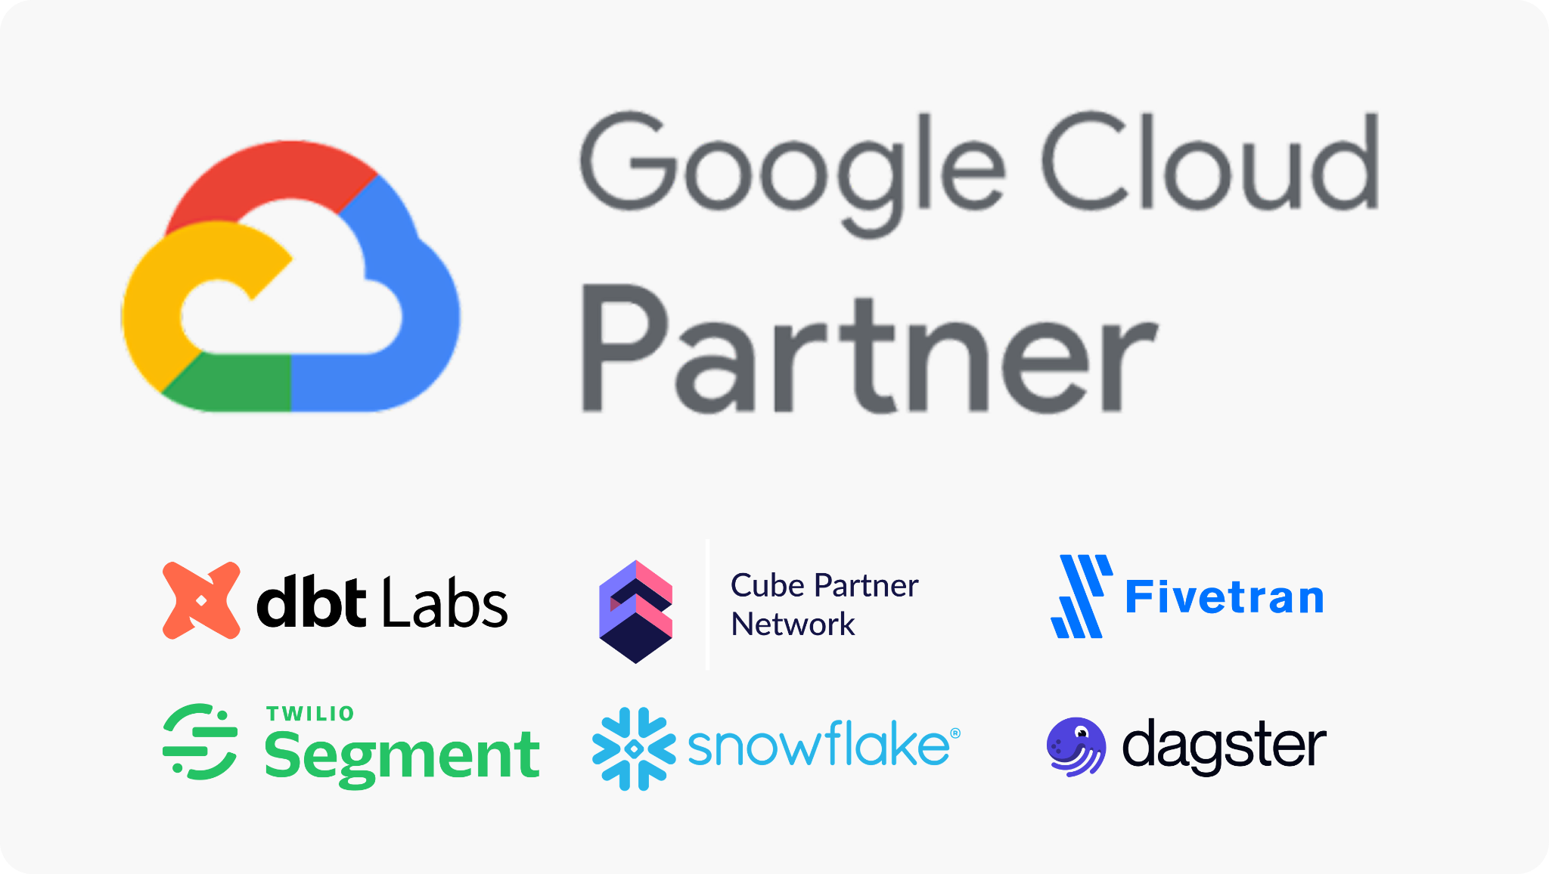
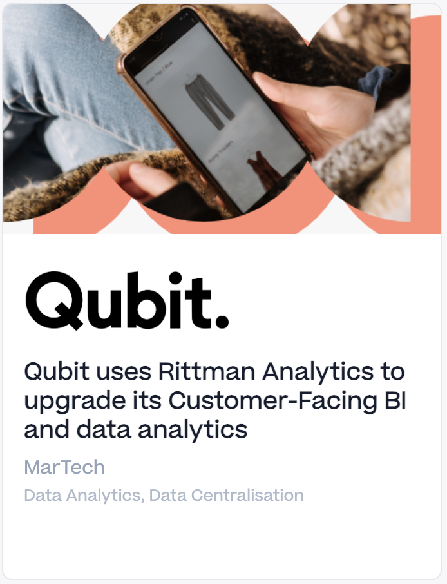
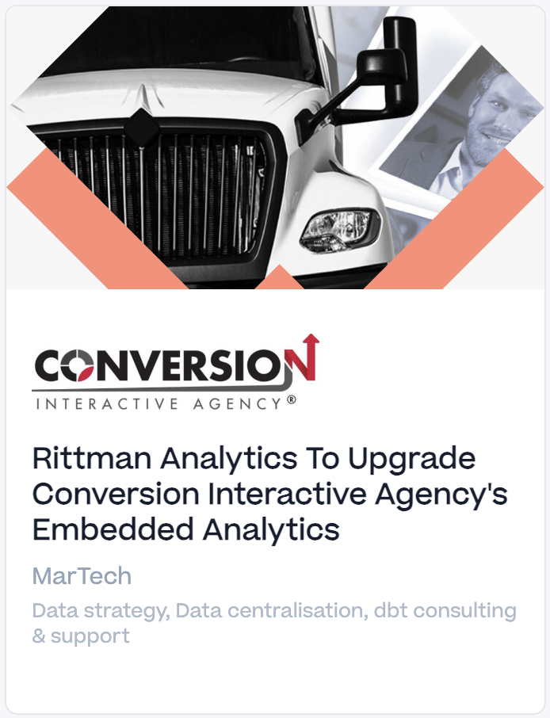
Rittman Analytics Expertise
Introductions
Technical Expertise
Example Project Implementations
Google Cloud Data Analytics Specialized Partner
Delivering Looker implementations since 2016
Snowflake Data Cloud Services Partner
Dbt Labs, Segment, Cube, Dagster, Fivetran partners
https://go.rittmananalytics.com/cia
https://go.rittmananalytics.com/qubit
https://go.rittmananalytics.com/live-tap

Slide 2
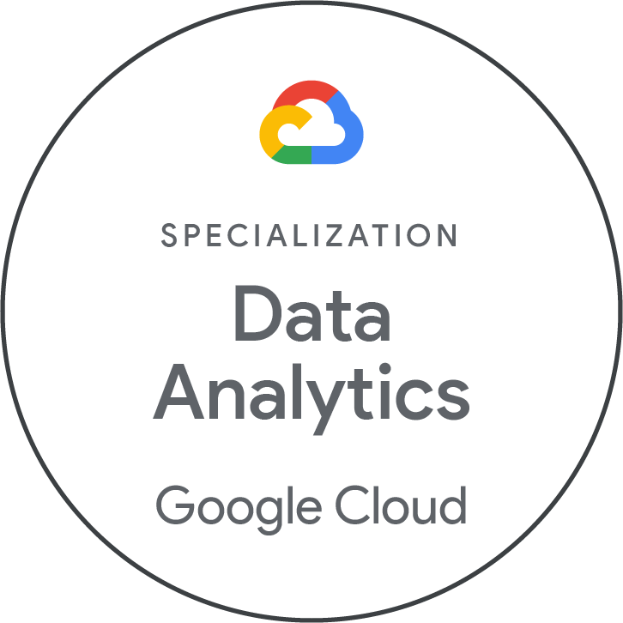
Rittman Analytics
INTRODUCTION
Analytics consultancy founded in 2018 by Mark Rittman
Based in Brighton, UK with clients in UK, EU and USA
Google Cloud Specialised Data Analytics Partner
Team of 10 Certified Google Cloud consultants
Specialists in Looker, BigQuery GCP stack
  5+ Years partnering with Looker, Google Cloud
  Cube, Fivetran, Dagster
  dbt Labs, Snowflake, Oracle
  Segment, Rudderstack, SnowCatCloud
We help high-growth data-rich businesses
  Define their data strategy
  Modernise their data stack
  Centralise their reporting data
  Scale their approach to data analytics

Slide 3
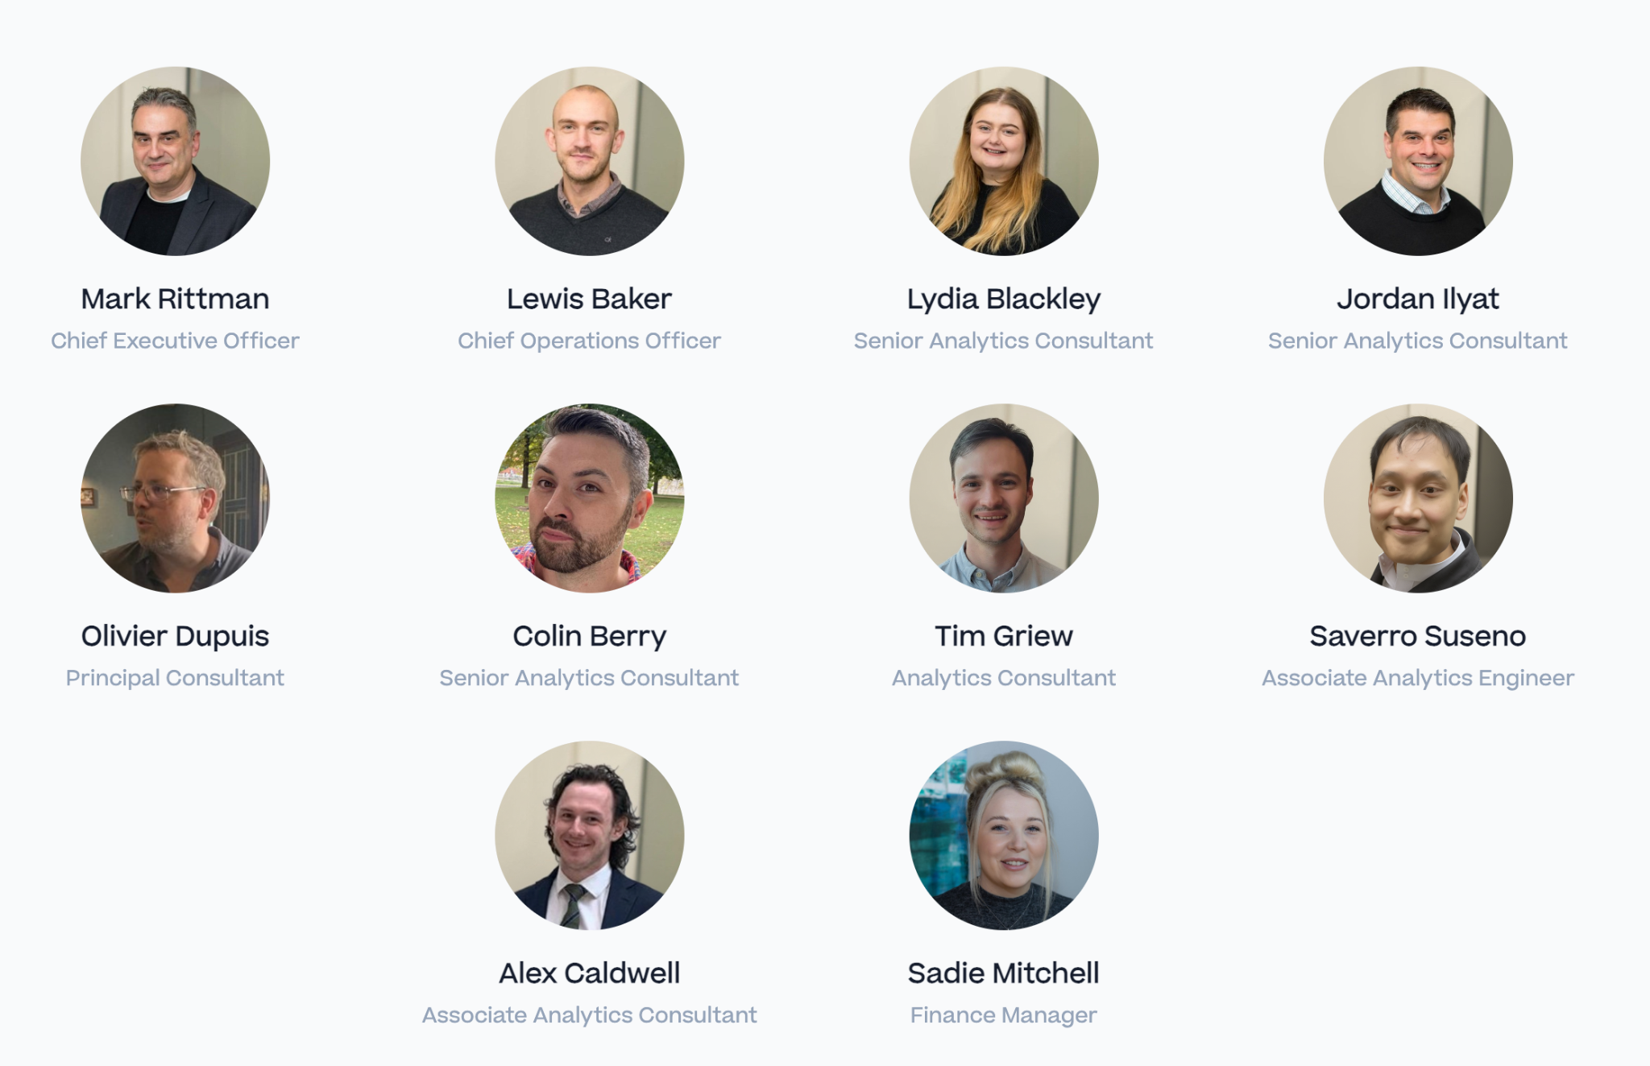
Our Team of Experts
Our team is composed of seasoned data strategists, architects, and analytics engineers with decades of combined experience.

